Slide 1
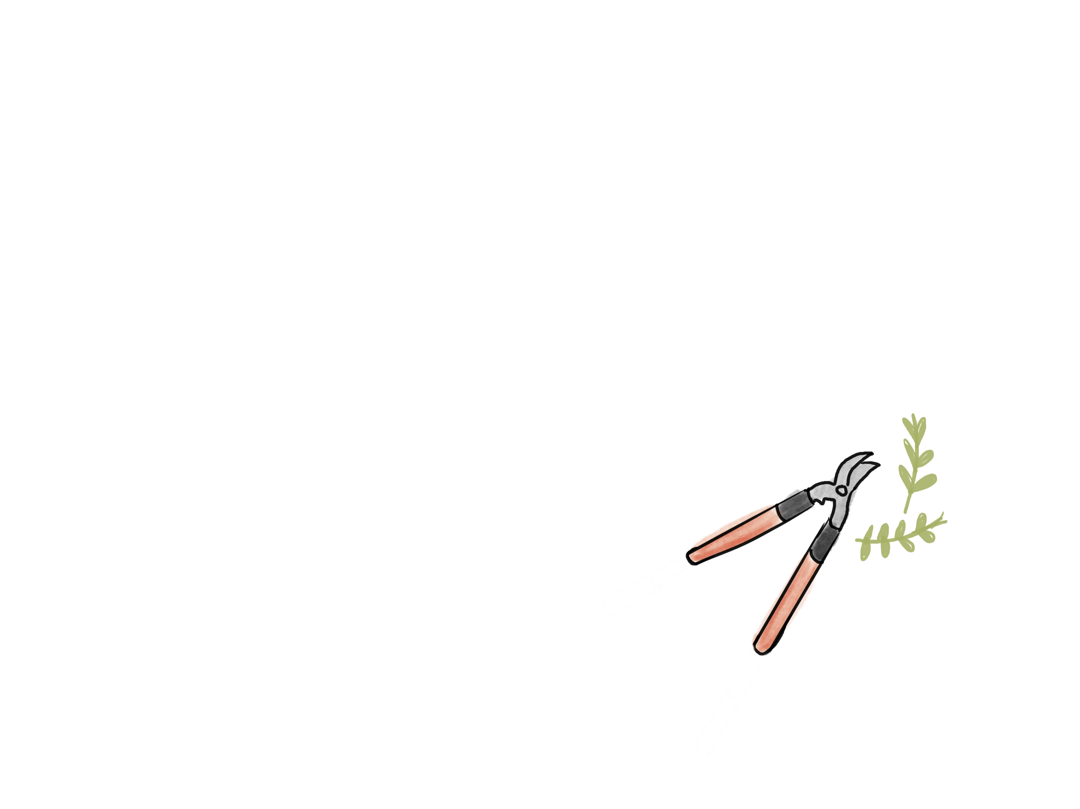
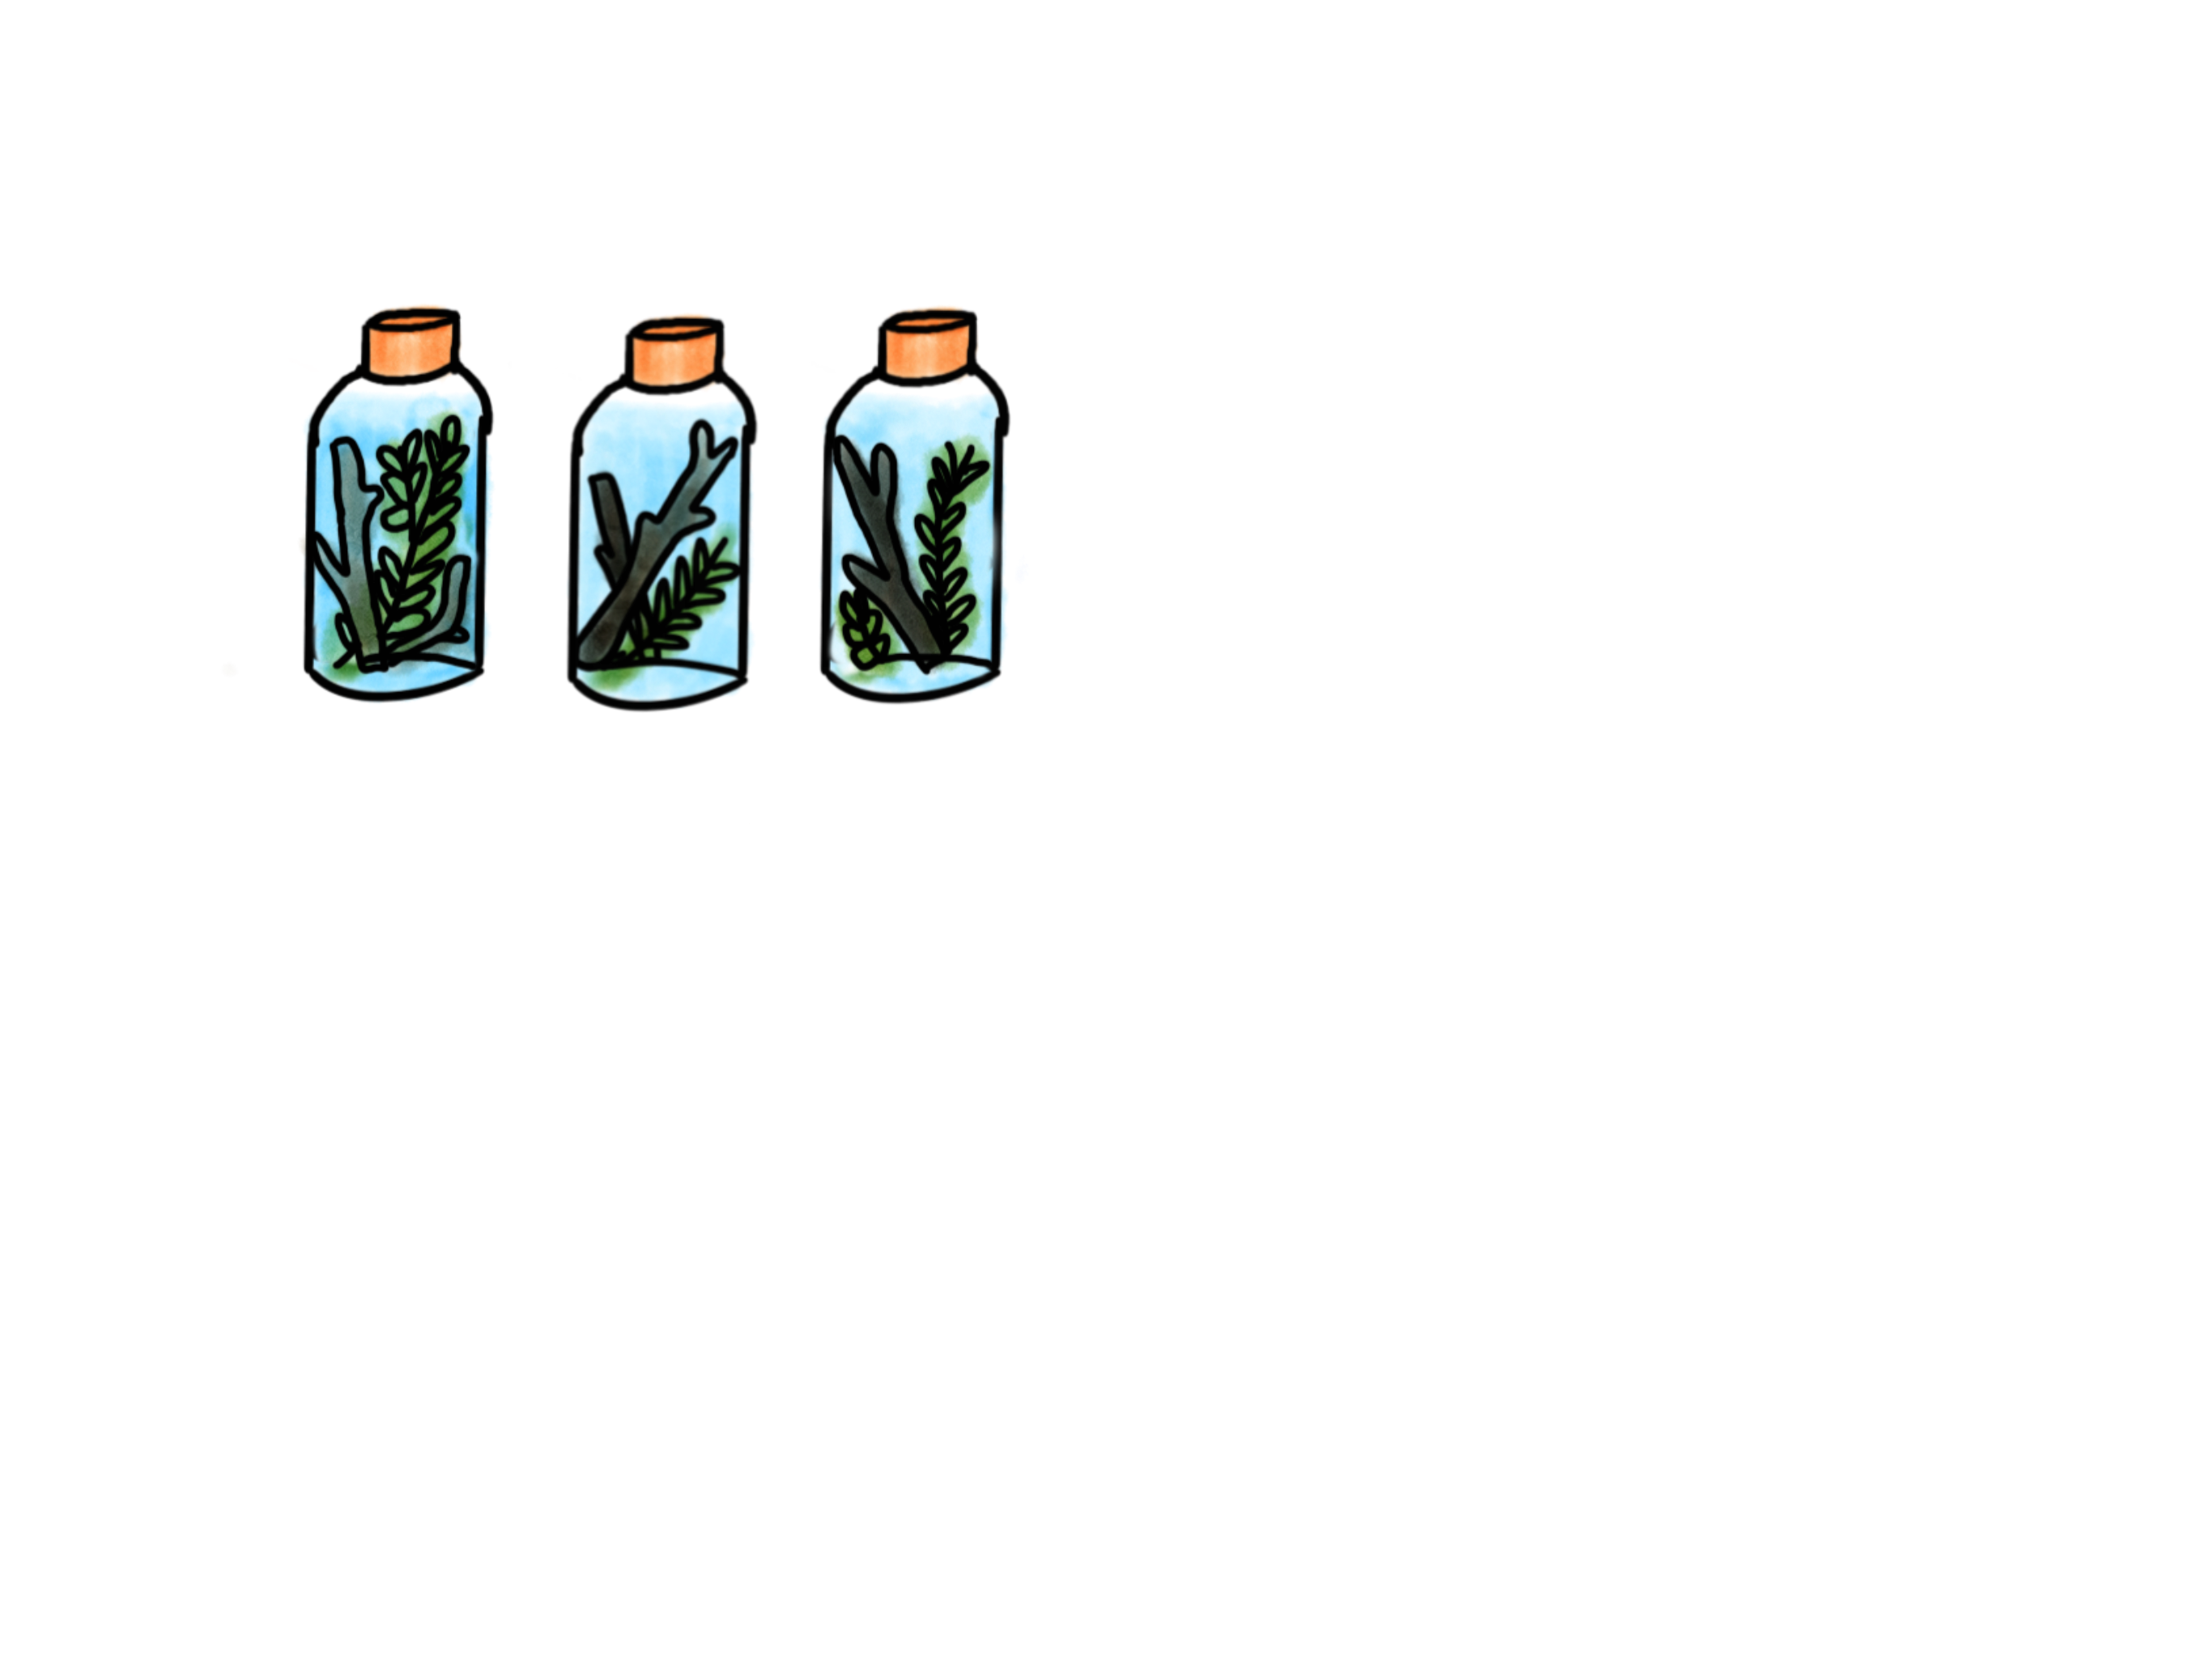
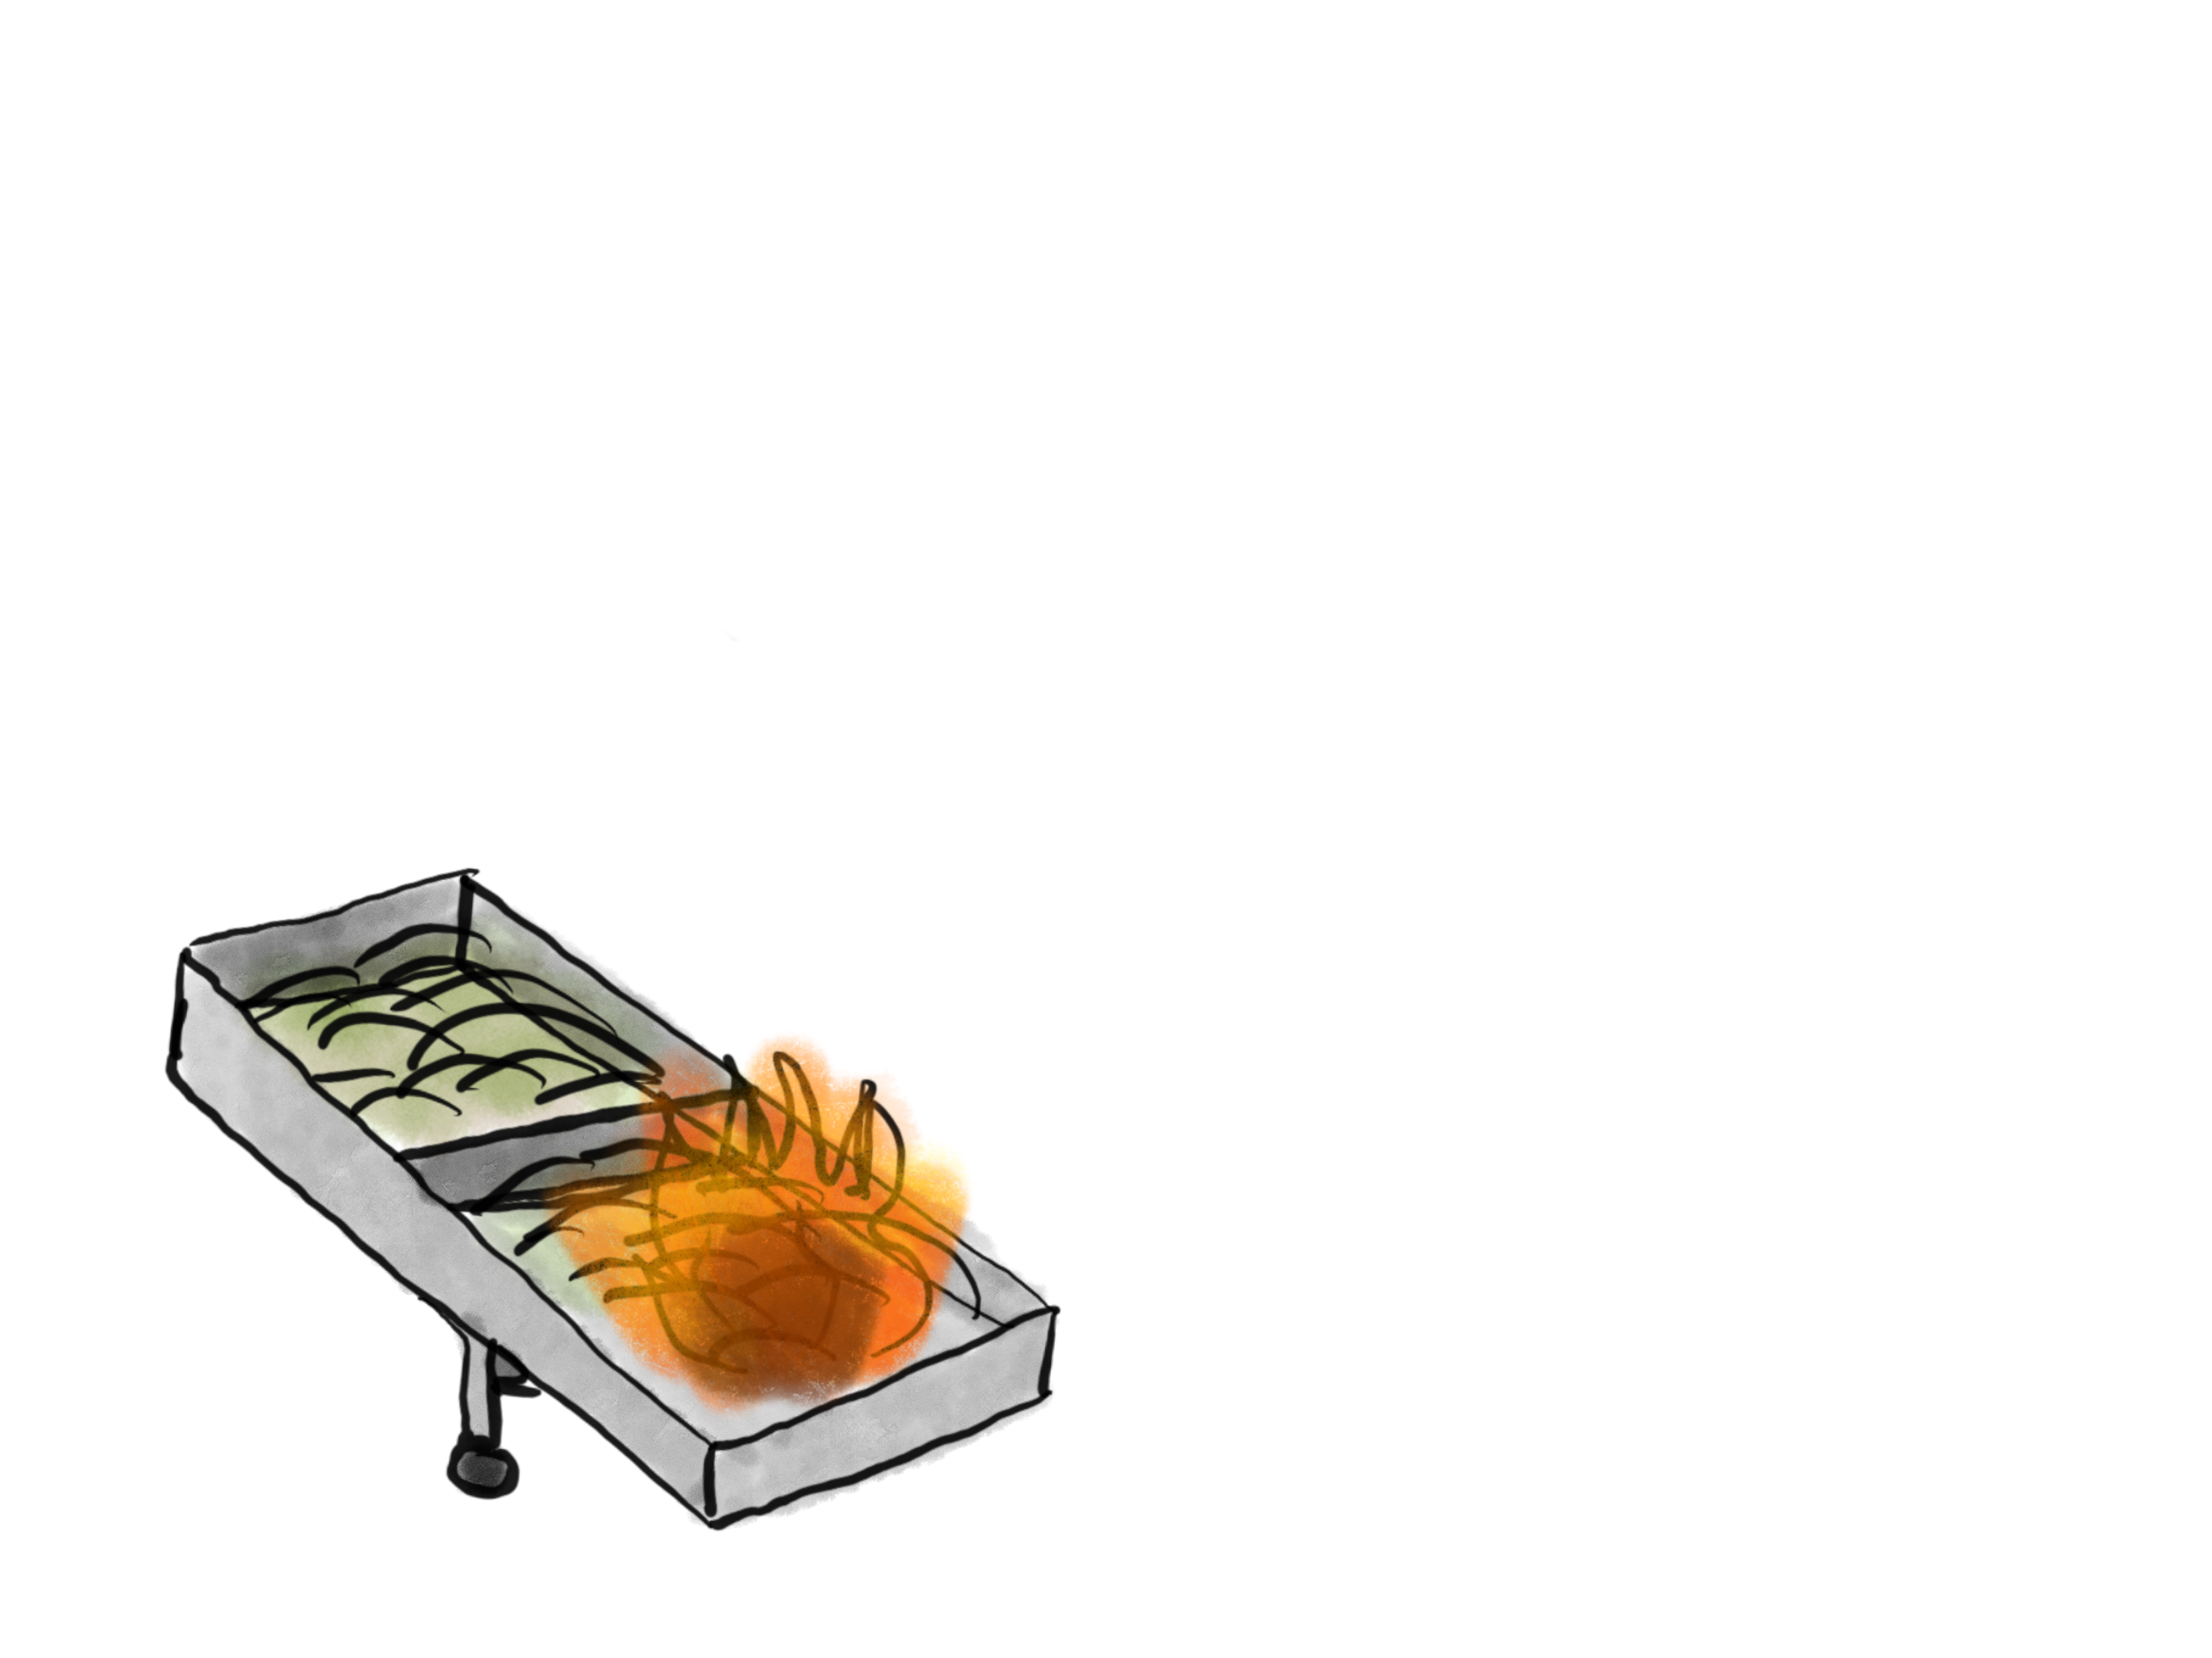
Burn Severity
Particulate Phase P
Leachates
Aqueous Phase P
Solid P Concentration
Solid Char
Organic P
Inorganic P: Ca, Mg

